Slide 1
Hacker Techniques, Tools, and Incident Handling
Chapter 5
Footprinting Tools and Techniques

Slide 2
Learning Objective
Identify common information-gathering tools and techniques.

Slide 3
Key Concepts
Information gathering––reasons, tools, and techniques
Footprinting as a data-gathering technique
Footprinting countermeasures
Google hacking

Slide 4
The Information-Gathering Process
Gathering information from general resources (such as Google or the organizations’ website)
Determining the network’s logical and physical dimensions
Identifying active computers and devices
Finding open ports, active services, and access points
Detecting operating systems
Researching known vulnerabilities of running software
Notes:
Footprinting covers the first two steps in the process.
Step 1 and at least part of step 2 are passive in nature; they do not require direct interaction with the victim.
This is one of the key characteristics of footprinting: to gather information about a victim without directly interacting and potentially providing advance notice of the attack.

Slide 5
The Information-Gathering Process (Cont.)
Footprinting activities:
Examine company’s website
Identify key employees
Analyze open positions and job requests
Assess affiliate, parent, or sister companies
Find technologies and software used by the organization

Slide 6
The Information-Gathering Process (Cont.)
Footprinting activities (cont.):
Determine network address and range
Review network range to determine whether the organization is the owner or if the systems are hosted by someone else
Look for employee postings, blogs, and other leaked information
Review collected data

Slide 7
The Information on a Company Website
Employee names and email addresses
Branch office locations
Technologies the organization uses

Slide 8
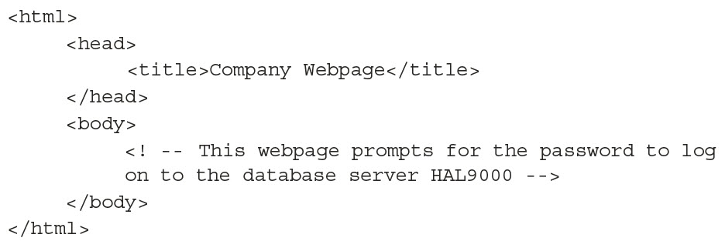
The Information on a Company Website (Cont.)
Notes:
While this HTML code may seem harmless, it tells an attacker the name of the server being accessed.

Slide 9
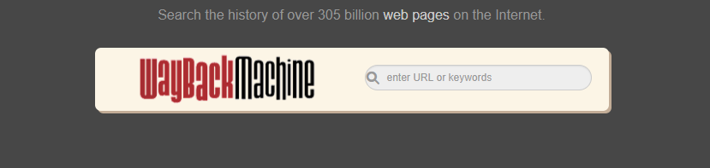
The Information on a Company Website (Cont.)
Notes:
The Wayback Machine is a tool that professionals use to gain information about past versions of a website.

Slide 10
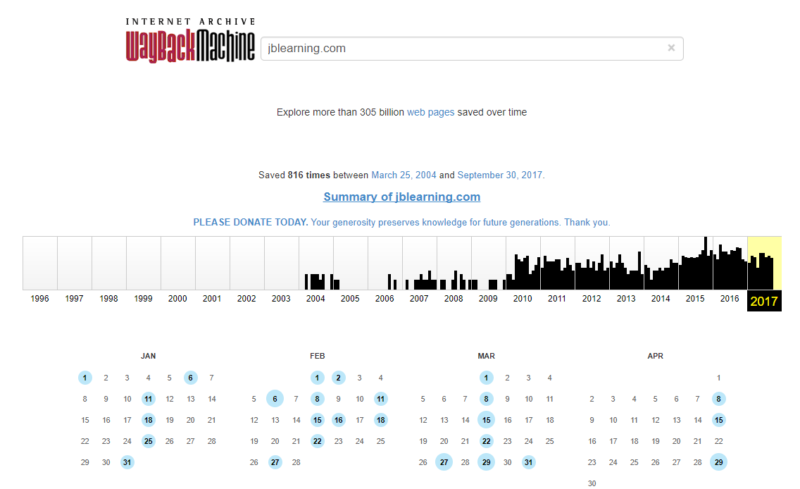
The Information on a Company Website (Cont.)
Notes:
Wayback Machine search results allows you to view the version of the website on a particular day. Internet Archives are not kept for all sites but results can go as far back as 1996.

Slide 11
The Information on a Company Website (Cont.)
Job postings give valuable clues into how its infrastructure is organized
Example:
Advanced knowledge of Microsoft Windows 8, Windows 10, Server 2008, Server 2012, Server 2016, Microsoft Office 2010, Office 2013, Office 2016, Microsoft SQL Server, Microsoft IIS, Visual Basic
Relevant experience/knowledge: Cisco PIX; Check Point Firewall helpful but not necessary
VMWare, SAP, and other data-gathering systems
Knowledge of Active Directory
Experience with Symantec Security Suite
Notes:
When examining job postings, IT should take note of the skills being requested.
This snippet of a larger job posting provides insight into what the company uses. An attacker could use the information to attempt to fine-tune a later attack, doing some research and locating vulnerabilities such as:
Vulnerabilities in the discovered products
Application-specific configuration issues
Product-specific defects

Slide 12
Discovering Financial Information
Securities and Exchange Commission (SEC) website: http://www.sec.gov
Electronic Data Gathering, Analysis, and Retrieval system (EDGAR) database
Hoover’s: http://www.hoovers.com/
Dun and Bradstreet: http://www.dnb.com/us/
Yahoo! Finance: http://finance.yahoo.com/
Bloomberg: http://www.bloomberg.com/

Slide 13
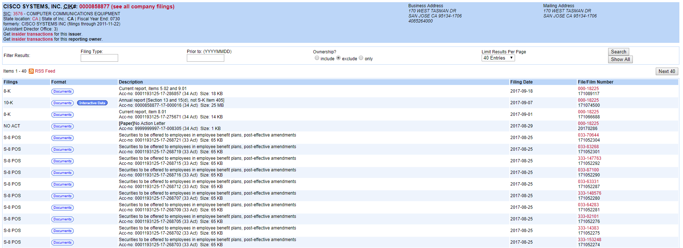
Discovering Financial Information (Cont.)
Notes:
EDGAR contains all sorts of financial information including:
Registration statements
Periodic reports
Other electronic forms
Quarterly and yearly reports (10-Qs and 10-Ks) that include names, addresses, financial data, and information about acquired or divested industries
Where company is based
Detailed financial information
Names of principals, including president and members of the board

Slide 14
Google Hacking
Goal is to locate useful information using techniques already provided by the search engine, in new ways
Can use Yahoo and Bing as well
Google Hacking Database (GHDB): www.offensive-security.com/community-projects/google-hacking-database/

Slide 15
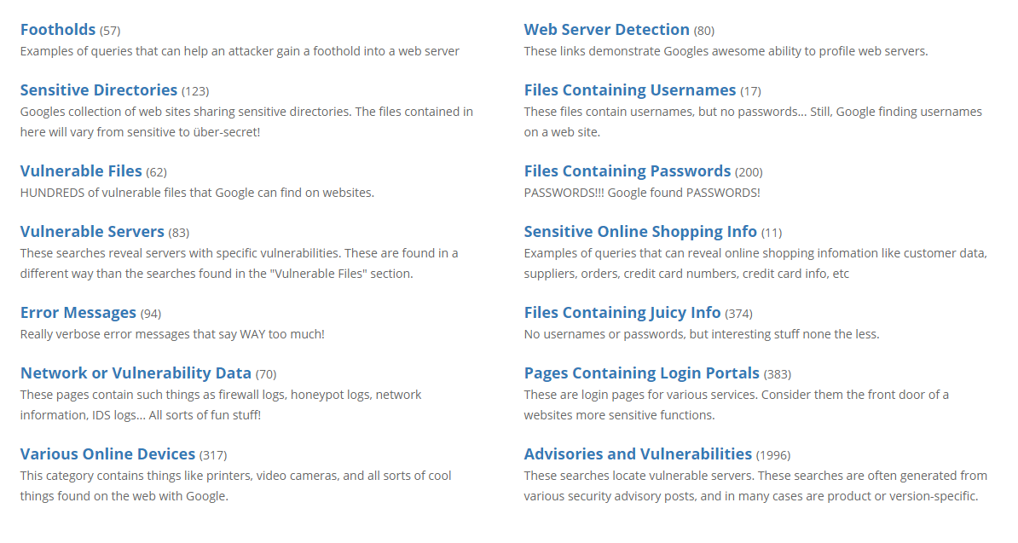
Google Hacking (Cont.)
Notes:
Google Hacking Database (GHDB)

Slide 16
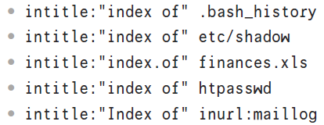
Google Hacking (Cont.)
intitle instructs Google to search for a term within the title of a document

Slide 17
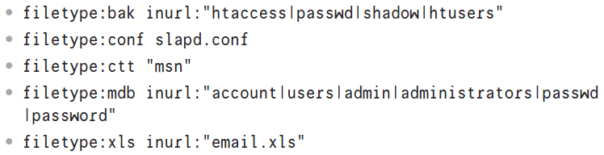
Google Hacking (Cont.)
filetype query allows the search to look for a particular term only within a specific filetype

Slide 18
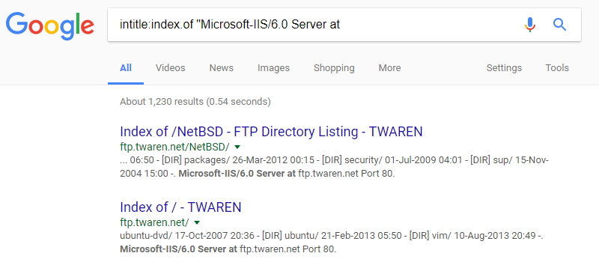
Google Hacking (Cont.)
Notes:
Google Hacking Database search results

Slide 19
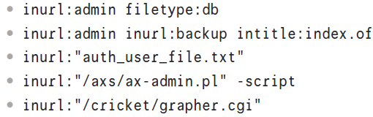
Google Hacking (Cont.)
Inurl string is used to search within a site’s uniform resource locator (URL)
Useful if attacker has some knowledge of URL strings or of standard URL strings used by different types of applications and systems

Slide 20
Exploring Domain Information Leakage
Manual registrar query
Automatic registrar query
Whois
Nslookup
Internet Assigned Numbers Authority (IANA)
Determining a network range

Slide 21
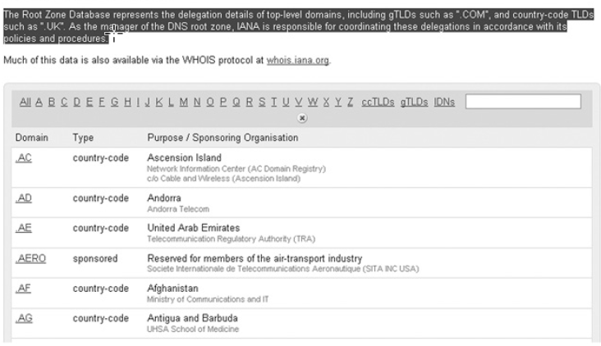
Manual Registrar Query
Notes:
Root Zone Database — Used to determine the network range manually
www.iana.org/domains/root/db/

Slide 22
Manual Registrar Query (Cont.)

Slide 23
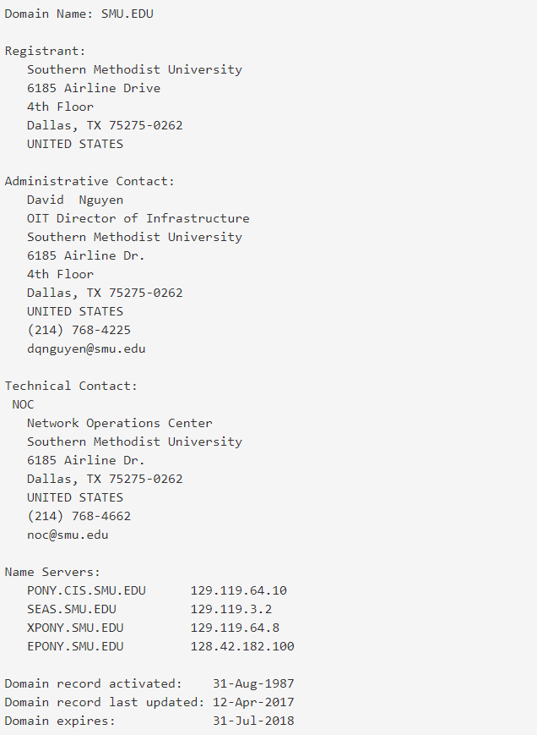
Manual Registrar Query (Cont.)

Slide 24
Manual Registrar Query (Cont.)
Notes:
Organization and planning are essential for security professionals.
Information should be noted for future use.
This table provides an example of an organization matrix.

Slide 25
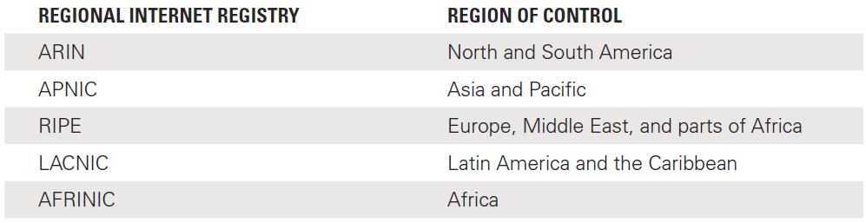
Manual Registrar Query (Cont.)
Notes:
Regional Internet Registries (RIRs) — Responsible for management, distribution and registration of public IP addresses within their assigned regions.
There are currently five primary RIRs.

Slide 26
Manual Registrar Query (Cont.)
Notes:
ARIN queries allow you to obtain information about the domain.

Slide 27
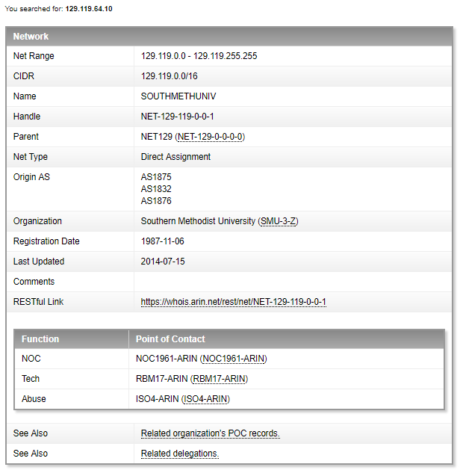
Manual Registrar Query (Cont.): ARIN Results

Slide 28
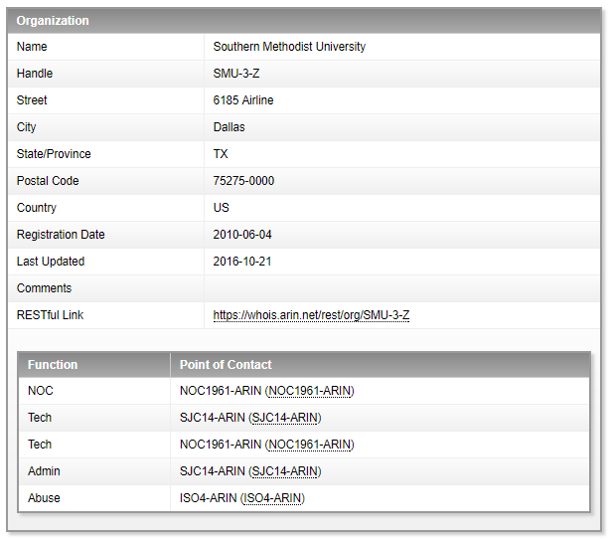
Manual Registrar Query (Cont.): ARIN Results

Slide 29
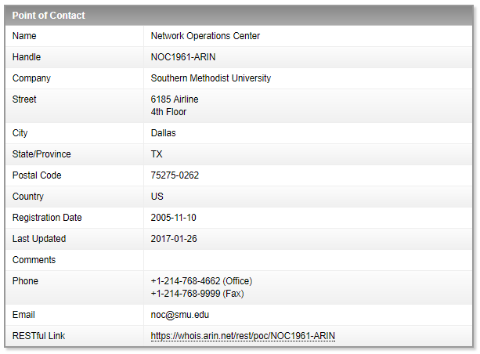
Manual Registrar Query (Cont.): ARIN Results

Slide 30

Manual Registrar Query (Cont.)

Slide 31
Automatic Registrar Query
http://www.betterwhois.com
http://geektools.com
www.all-nettools.com
www.smartwhois.com
www.dnsstuff.com
http://whois.domaintools.com

Slide 32
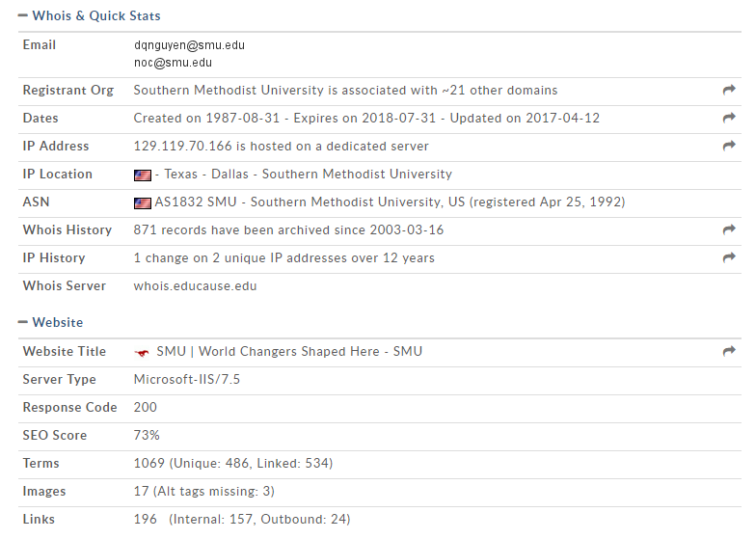
Automatic Registrar Query (Cont.)
Notes:
Image shows results using http://whois.domaintools.com to query information on http://www.smu.edu.

Slide 33
Whois
Queries databases that hold registration information
Designed to interrogate the Internet DNS and return domain ownership, addresses, location, phone number, etc.
Accessibility of tool depends on operating system

Slide 34
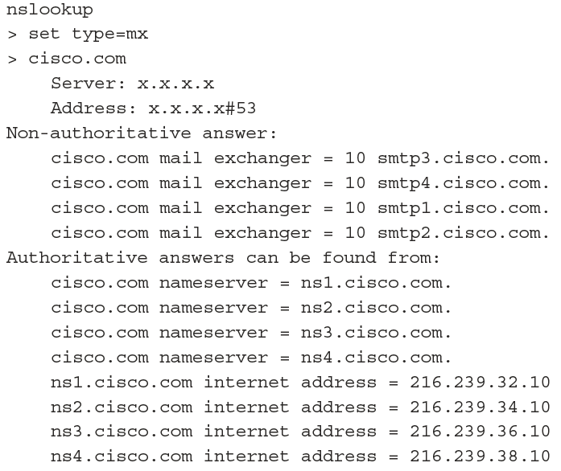
Nslookup

Slide 35
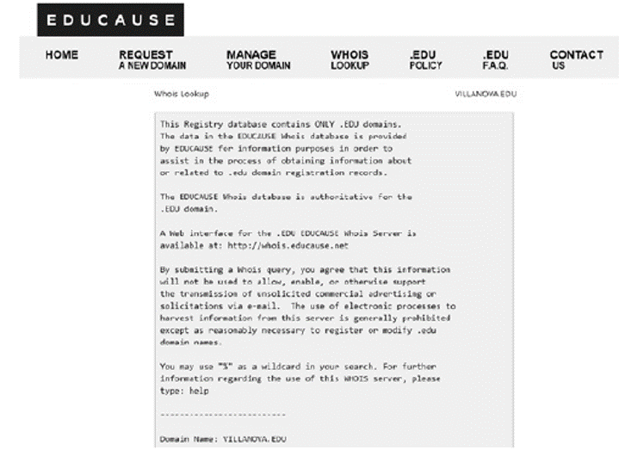
Internet Assigned Numbers Authority (IANA)
Notes:
IANA is responsible for global coordination of the DNS root, IP addressing and other Internet protocol resources.
The image shows the results of a domain services.

Slide 36
Determining a Network Range
American Registry for Internet Numbers (ARIN)
North America and parts of the Caribbean
Réseaux IP Européens Network Coordination Centre (RIPE NCC)
Europe, the Middle East, and Central Asia
Asia-Pacific Network Information Centre (APNIC)
Asia and the Pacific Rim
Latin American and Caribbean Internet Addresses Registry (LACNIC)
Latin America and parts of the Caribbean region
African Network Information Centre (AfrNIC)
Africa

Slide 37
Traceroute
Software program that helps to determine the path a data packet traverses to get to a specific IP address
One of the easiest ways to identify the path to a targeted website
In Windows operating systems, the command is tracert
In UNIX/Linux, the command is traceroute
Traceroute displays list of routers on a path to a network destination by using time-to-live (TTL) time-outs and Internet Control Message Protocol (ICMP) error messages

Slide 38
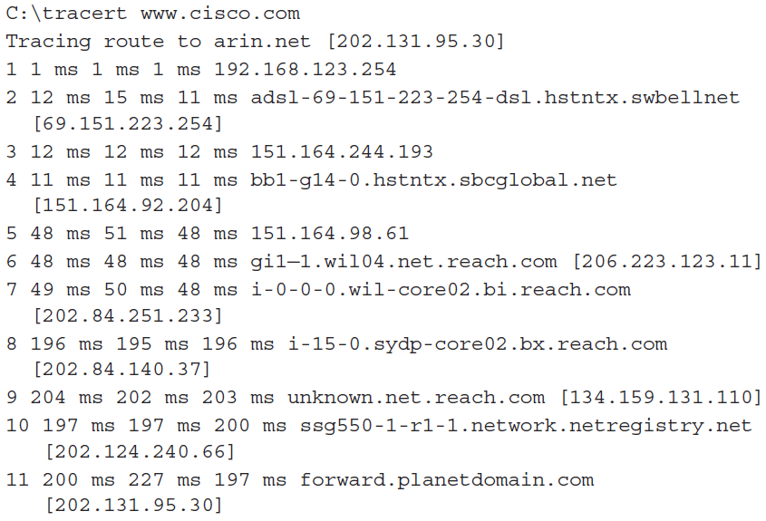
Traceroute (Cont.)

Slide 39
Tracking an Organization’s Employees
Information that can be uncovered online:
Posted photographs, videos, or information
Posted content about personal activities, political or activist affiliations, and beliefs
Posting derogatory information about previous employers, coworkers, or clients
Discriminatory comments or fabricated qualifications

Slide 40
Tracking an Organization’s Employees (Cont.)
These sites can be examined for names, email addresses, addresses, phone numbers, photographs, and so on:
Blogs
Personal pages on a social networking site, such as Facebook, YouTube, LinkedIn, Instagram, Twitter, sucks domains
Organizational social medial outlet pages

Slide 41
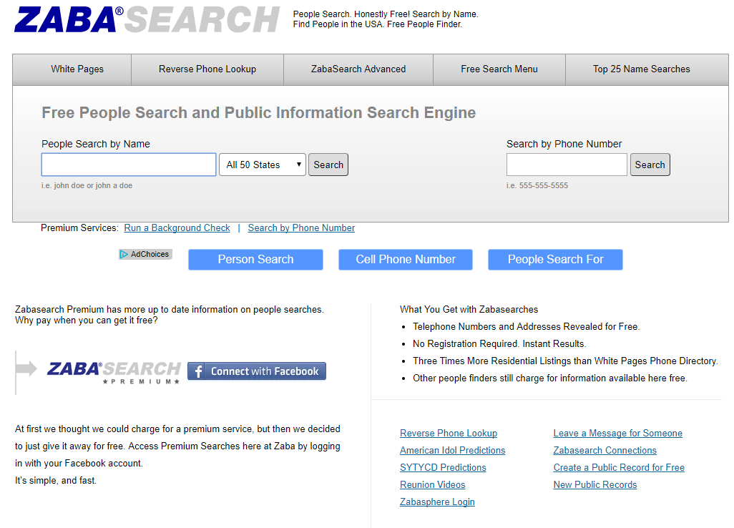
Tracking an Organization’s Employees (Cont.)
Notes:
Site that gather or aggregate information is an easy way of gaining information.
Zabasearch (www.zabasearch.com/) and Spokeo (www.spokeo.com) are sites which accumulate data from multiple sources.

Slide 42
Exploiting Insecure Applications
Telnet
File Transport Protocol (FTP)
The “r” commands
Post Office Protocol (POP)
Hypertext Transfer Protocol (HTTP)
Simple Network Management Protocol (SNMP)

Slide 43
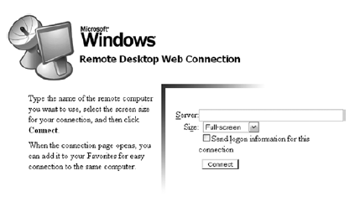
Exploiting Insecure Applications (Cont.)

Slide 44
Using Social Networks
Facebook, LinkedIn, Twitter, etc.
Be aware of potentially malicious URLs
Example: Clicking a video can be linked to malicious site that steals victims’ credentials or other information
Website could install malicious software onto the user’s system
Innocent-looking items (trivia items, fantasy sports, etc.) may distribute or publish user information
Profile information valuable to ethical and nonethical hackers

Slide 45
Using Basic Countermeasures
Website
Google hacking
Job listings
Domain information
Social media posts
Insecure applications
Securing DNS

Slide 46
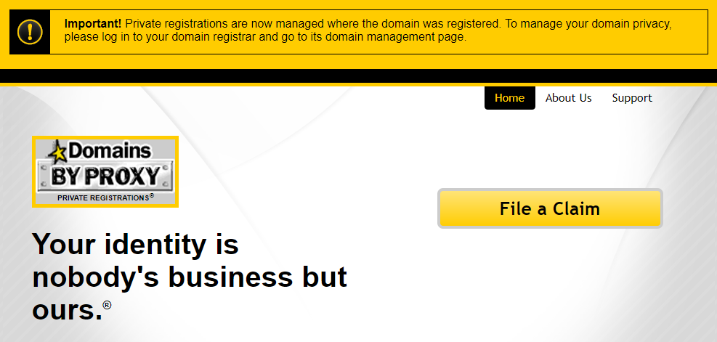
Using Basic Countermeasures (Cont.)

Slide 47
Summary
Information gathering––reasons, tools, and techniques
Footprinting as a data-gathering technique
Footprinting countermeasures
Google hacking

